Slide 1


Slide 2
Agenda
Basic Terraform project and it’s limitations
What is Terragrunt
Basic project structure and code walk
Landing Zone project structure
Pipelines and Terragrunt
CI/CD and Terragrunt
The future

Slide 3
Notes:
Basic Terraform and it’s limitations

Slide 4
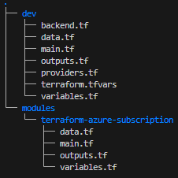
Create a sub in Dev
Simple Terraform project
Module parametrised and reusable
Backend.tf, providers.tf and terraform.tfvars in dev are all hard-coded
Notes:
El classic!

Slide 5
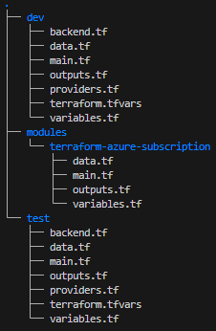
Scale out and create a sub in Test
Simple Terraform project
Module parametrised and reusable
Backend.tf, providers.tf and terraform.tfvars in dev, test are all hard-coded
Notes:
Double El Classico

Slide 6
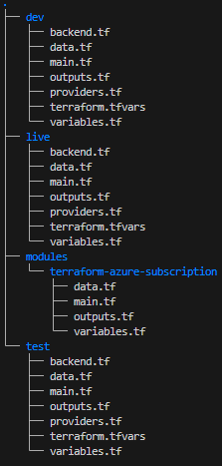
Scale out further and create a sub in Live
Simple Terraform project
Module parametrised and reusable
Backend.tf, providers.tf and terraform.tfvars in dev, test and live are all hard-coded
Notes:
Triple El Classico!

Slide 7
Looks great, but could we…
Share common variables?
Use string interpolation in providers.tf, .tfvars and backend.tf configuration?
Avoid repetition of main.tf etc. in each folder?
Find a way to scale to multiple modules?

Slide 8

Notes:
You’re going to do two things here –
Firstly you’ll write a bunch of Terraform calling multiple modules creating super-sized state-files with CV generating blast radius’
Secondly you write a large unwieldy bash script that grows and grows with the potential to eventually become self-aware, enslave humanity and we’ll all have to be saved by Keanu-Jesus

Slide 9

Notes:
No one understands it

Slide 10
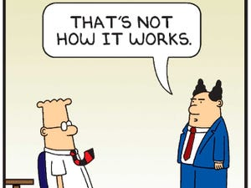
Everyone hates you and Christmas is ruined
Notes:
And feedback is poor
But
Luckily just like Keanu-Jesus, I am here to save you

Slide 11
Notes:
What is Terragrunt?

Slide 12
What is Terragrunt?
It’s a wrapper for Terraform written in Go that extends Terraform’s functionality and makes your code DRYer
Notes:
READ FIRST
In marketing speak it’s…

Slide 13
What is Terragrunt?
It’s a wrapper for Terraform written in Go that extends Terraform’s functionality and makes your code DRYer
Or..

Slide 14
What is Terragrunt?
It’s a wrapper for Terraform written in Go that extends Terraform’s functionality and makes your code DRYer
Or..
It’s a series of instructions that collect shared files from your folder hierarchy to build a Terraform module in a specified folder

Slide 15
Notes:
Let’s look at basic Terragrunt project structure

Slide 16
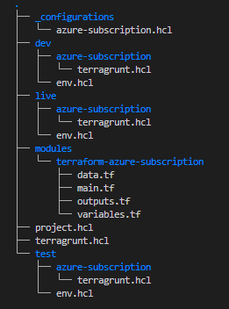
The same sub project in Terragrunt
Notes:
READ LAST
The folder structure is one of the most important things in Terragrunt
It defines our environments
And we can use it along with functions to keep our code DRY
The components are…

Slide 17
The same sub project in Terragrunt
Configuration file
Notes:
READ LAST
It’s responsible for calling the module and configuring the module
It’s in a folder handily called _configuration
The underscore at the start of _configuration is a naming convention
we prefix with _ to indicate that this folder doesn’t contain deployable configurations

Slide 18
The same sub project in Terragrunt
Configuration file
Child file/folder
Notes:
READ LAST
This is where the magic happens
The file has instructions to start copying in files
A .terragrunt folder is created, the local terraform module is built here along with the dependant modules
Terragrunt plan/apply and destroy are run from this folder to instantiate a single module

Slide 19
The same sub project in Terragrunt
Configuration file
Child file/folder
Root file
Notes:
READ LAST
This is a shared folder with Terragrunt functions that dynamically create the remote state and providers files for Terraform

Slide 20
The same sub project in Terragrunt
Configuration file
Child file/folder
Root file
Common and environment variables
Notes:
READ LAST
Shared variables for all the modules, a big improvement on Terraform’s flat file structure and repeated .tfvars

Slide 21
Child file
The child terragrunt.hcl file has two instructions:
Notes:
READ FIRST
So, codewalk..

Slide 22

Child file
The child terragrunt.hcl file has two instructions:
Copy the root file containing the provider and remote state configuration into this directory

Slide 23
Child file
The child terragrunt.hcl file has two instructions:
Copy the root file containing the provider and remote state configuration into this directory
Copy the configuration file for my module into this directory

Slide 24
Child file
The child terragrunt.hcl file has two instructions:
Copy the root file containing the provider and remote state configuration into this directory
Copy the configuration file for my module into this directory
Note the function in this interpolation
Notes:
I think this is the trick with Terragrunt
Using logic and functions to reduce any hardcoding to a minimum
Let’s take a look at the first file it copied, the root file

Slide 25
Root file
The root terragrunt.hcl file creates remote state and the providers
Terragrunt will dynamically create files called providers.tf and backend.tf, and add them to the Terraform files in the child directory ready for instantiation

Slide 26
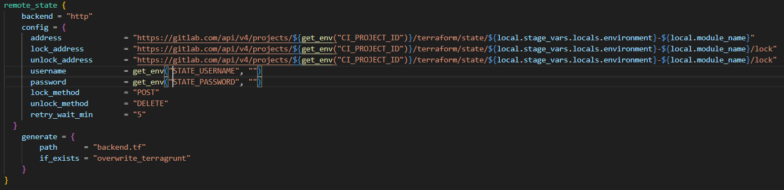
Root file
The remote_state block can use interpolation from locals and environment variables passed in from the GitLab runner

Slide 27
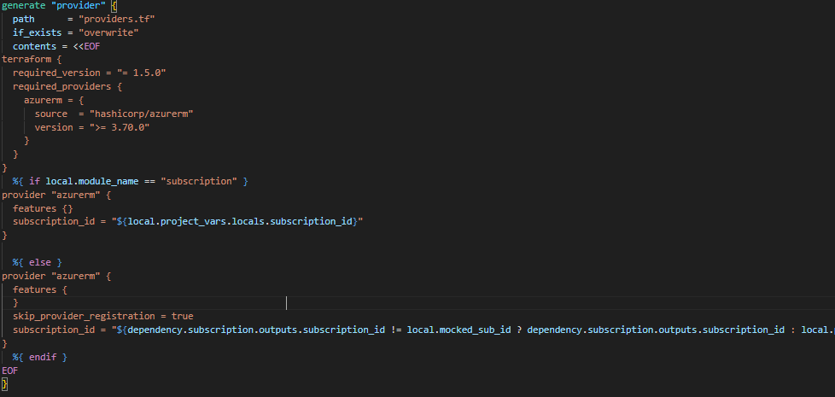
Root file
Providers are created in a generate block
The generate block is pretty flexible and can use Heredoc conditionals

Slide 28
Configuration file
The configuration file has several instructions:
Copy the Terraform module into the child folder
Notes:
READ FIRST
As mentioned, the configuration file is responsible for calling the module and configuring the module

Slide 29
Configuration file
The configuration file has several instructions:
Copy the Terraform module into the child folder
Note the use of versioned modules – this gives us control over the upstream modules
Notes:
READ LAST
The modules in the tree are only here for the demonstration, they will be their own GitLab projects
I’ve been documenting my module updates in the release notes
And carrying the release information onto the Terragrunt project release once the module has been tested and the source version here incremented

Slide 30
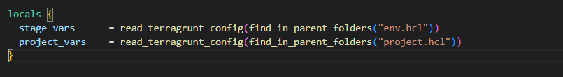
Configuration file
The configuration file has several instructions:
Copy the Terraform module into the child folder
Read the variable values listed in locals

Slide 31
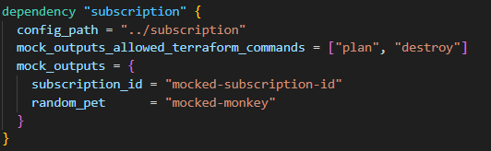
Configuration file
The configuration file has several instructions:
Copy the Terraform module into the child folder
Read the variable values listed in locals
Read the values of any configured dependent modules
Notes:
READ LAST
Although the sub module doesn’t have any dependencies, other modules such as virtual network do
Virtual-network for example will need the newly created sub ID and we use these dependency blocks to pass information from one module to another
They also create a resource graph in Terragrunt for creating multiple modules at once from a pipeline

Slide 32
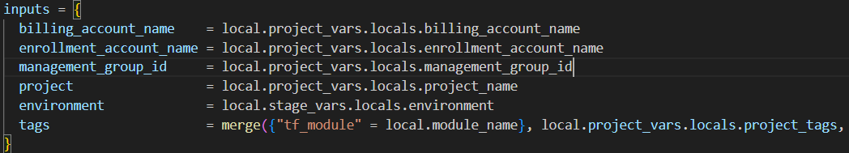
Configuration file
The configuration file has several instructions:
4. Articulate the inputs
Note that all values are in projects.hcl or env.hcl so they are available to all modules

Slide 33
A note on path based functions
Functions in the root and configuration files will see themselves in the child folder – ie. /dev/azure-subscription

Slide 34
A note on path based functions
When run, the locals values copied in from env.hcl and project.hcl will execute themselves in their original position – /dev and /

Slide 35
Using path based functions
This file was copied into /dev/subscription and I can use a function to read the folder name & use Heredoc to solve chicken and egg issues with the provider configuration
Notes:
READ FIRST
One of the first issues we had was with the sub and virtual network modules using different sub IDs
I didn’t want to have to create two providers and looked for some logic I could build in that would differentiate
READ AFTER
If the folder this file is copied into is called subscription, the providers will be created using the locals value subscription_id – a pipeline variable with the backend management sub ID
If the folder this file is copied into is called anything else, the providers will be created using a dependency value passed in by the sub module – the newly created sub ID
This is the magic of generate blocks

Slide 36
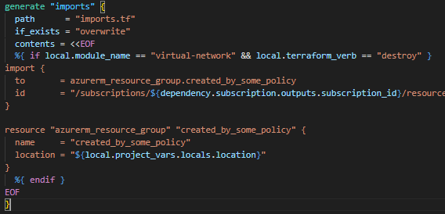
Generate Blocks
Not restricted to creating providers and are a handy tool when coupled with Heredoc logic

Slide 37
Generate Blocks
In this example I’m dynamically creating an imports.tf to import resources created by policy into the virtual-network state-file on destroy
Here’s local.module_name:

Slide 38
Generate Blocks
local.terraform_verb is the pipeline job stage being read by Terragrunt
Terragrunt will read the runner’s environment variables without the TF_VAR_ prefix required by Terraform
Notes:
READ FIRST
And I thought this was quite cool..
READ AFTER
This gives a ton of extra flexibility and we can really dig into all the environment vars on the runner

Slide 39
Notes:
Landing Zone project structure

Slide 40
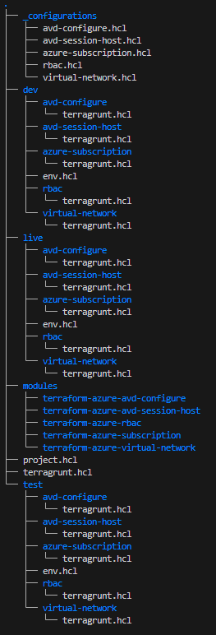
Landing Zone
Scaled out for a Landing Zone with a Subscription, vNet, AVD Jump Boxes and RBAC
Modules shown for demonstration purposes
Notes:
Don’t be scared

Slide 41
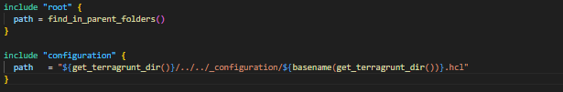
Landing Zone
It looks like a lot of files, but all the child terragrunt.hcl files are identical and use the folder name to pull in the configuration files
Lots of small state-files to limit the blast radius when carrying out changes

Slide 42
Landing Zone
The configuration files and common locals are shared between Dev, Test and Live

Slide 43
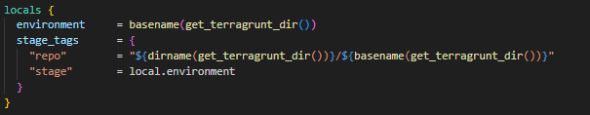
Landing Zone
The environment specific env.hcl files are identical in Dev, Test and Live
This isn’t a hard rule
Notes:
And now a quick section on tags

Slide 44
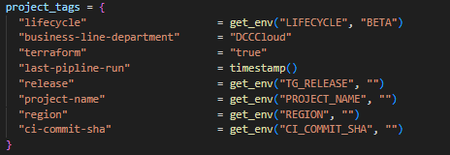
Tags
Tags are important and information is gathered from different parts of the project to add to resources
Pipeline and common tags in project.hcl
Notes:
Lots of pipeline information here

Slide 45

Tags
Tags are important and information is gathered from different parts of the project to add to resources
Environment tags in env.hcl

Slide 46
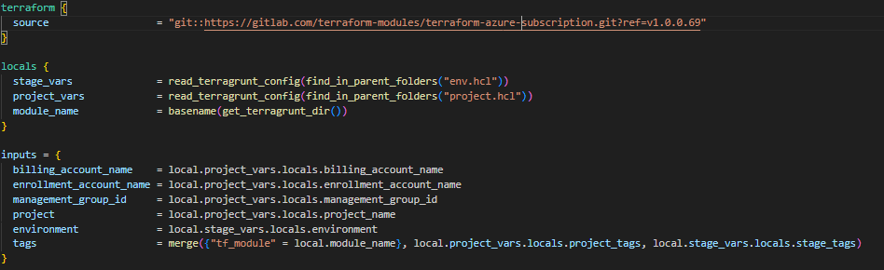
Tags
Tags are important and information is gathered from different parts of the project to add to resources
Module tags in the configuration files
Notes:
And remember..
I have to run local.module_name here because it’s the configuration file and copied into the child folder and able to reference the child folder name.
If I ran this function in project.hcl and called it as local.project_vars.locals.module_name it would list project.hcl’s folder name – terragrunt-landing-zone

Slide 47
Notes:
Pipelines and Terragrunt

Slide 48
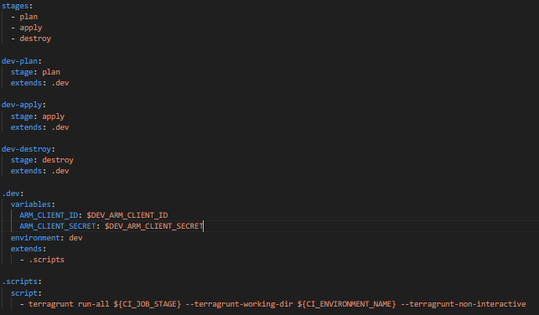
Pipeline automation
Terragrunt can be run from root and will run plan, apply or destroy on all the folders using the run-all command

Slide 49
Pipeline automation
Terragrunt can be run from root and will run plan, apply or destroy on all the folders using the run-all command
It can also filter to a directory using --terragrunt-working-dir

Slide 50
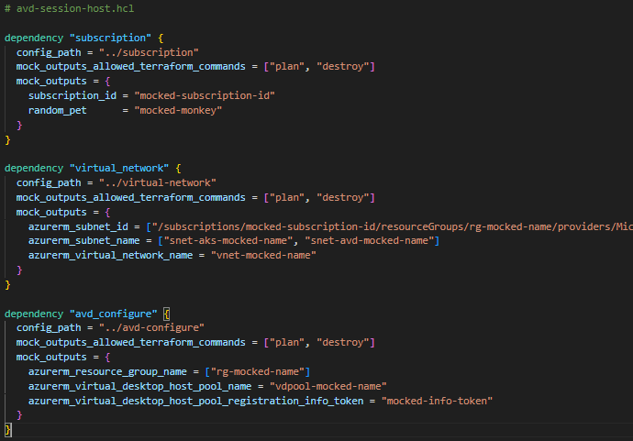
Pipeline automation
Terragrunt will work out the order of operation from dependencies in the configuration files

Slide 51
Pipeline automation
Terragrunt will work out the order of operations from dependencies in the configuration files
subscription.hcl has no dependencies and will run first
avd-session-host.hcl has three dependencies configured and is one of the last modules to be created

Slide 52
Pipeline automation
The runner is copying the state-files for every dependency into the child folder, hence the mocked_outputs to cover any gaps
It is ephemeral and destroyed with the job container on completion
Notes:
In the background…

Slide 53
Imperfections
Terragrunt isn’t written for pipelines and care is needed as Terraform has no error handling
Any values passed from one module to another need to be mocked during terragrunt plan on virgin projects as there are no state-files to read outputs from – it will fail without them
You can’t save a copy of plan and later apply it

Slide 54
Imperfections
You can’t pass information from a module up to Terragrunt, for example data sources can’t be read
If you can build the logic into the module, do that – otherwise, break your module into smaller modules
In this example, avd-configure is a separate module to avd-session-host so Terragrunt can read the avd-configure outputs
Notes:
IN THE MIDDLE
For Jim Brikman sayeth –
you should build your code out of small, standalone, reusable, composable modules

Slide 55
Notes:
CI/CD and Terragrunt

Slide 56






Terragrunt CI/CD – Development Pipeline
Feature Branch – Dev only
Code in Dev on a feature branch.
Dev

Slide 57
Terragrunt CI/CD – Development Pipeline
Feature Branch – Dev only
When the code is tested and production ready…
Dev

Slide 58
Terragrunt CI/CD – Development Pipeline
Feature Branch
Merge Request
Merge branch…
Dev
Notes:
Once a merge request has been submitted there’s no more dev work and we’re testing the code in Test and Live and releasing it for production use
Remember this is a dev pipeline not deployment and everything will be destroyed on completion

Slide 59
Terragrunt CI/CD – Development Pipeline
Triggering the main pipeline
Main

Slide 60


Terragrunt CI/CD – Development Pipeline
Package and sign Terragrunt folder
Upload to Artifactory
Main

Slide 61
Terragrunt CI/CD – Development Pipeline
Test and Live environments pull the package from Artifactory
Check the signature
Run Terragrunt run-all apply in both environments
Main
Private
Test
Private
Live
Notes:
READ AFTER
If both Landing zones have been successfully built..

Slide 62
Terragrunt CI/CD – Development Pipeline
Destroy Test and Live deployments
Create a project release in GitLab documenting the new features
Make package public and versioned in Artifactory
Main
Private
Test
Private
Live
Test/Live
Release
Public
Notes:
READ FIRST
There is no more need for them and we..

Slide 63

Terragrunt CI/CD – Deployment Pipeline
New Landing Zones are built from a GitLab template project using API calls
API Calls
Create new project from template
Pipeline variables
Run pipeline
Notes:
READ FIRST
This is how we’ve automated Landing Zone deployments

Slide 64
Terragrunt CI/CD – Deployment Pipeline
Terragrunt and the upstream modules have no hardcoded parameters
All values are passed in as environment variables by the pipeline
This includes the version of Terragrunt being downloaded from Artifactory
API Calls
TG_RELEASE : “V1.0.0.612”
BILLING_ID : “123456789A”
REGION : “uksouth”

Slide 65
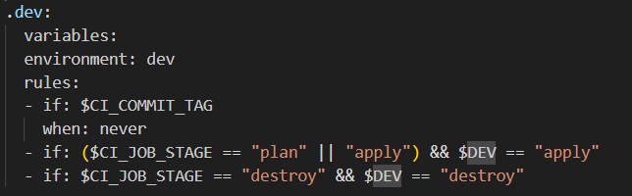
Terragrunt CI/CD – Deployment Pipeline
Variables also act as switches on pipeline rules
API Calls
DEV : “apply
TEST : “skip”
LIVE : “destroy”
Notes:
IGNORE SLIDE TEXT
We’ve built logic into the Gitlab template pipeline rules so that Variables also act as switches on pipeline rules
In this example,
DEV : apply will match the first rule and the pipeline will run dev plan and dev apply
Alternatively
DEV: destroy would match the second rule and run dev destroy
Or
DEV : skip matches no rules and no jobs would be run in dev

Slide 66

Terragrunt CI/CD – Deployment Pipeline
API Calls
Create new project from template
Pipeline variables
Run pipeline
Template Pipeline
Env vars
Public
Dev
Env vars
Public
Test
Env vars
Public
Live

Slide 67
Notes:
Things I would have done if there was more time

Slide 68
I think you should..
K8S infra module with on/off switch
Separate K8S repo with Flux using Terraform for GitOps
Thorough Pytest Integration testing in CI/CD
Consolidate API calls using Flask or API gateway and Azure functions

Slide 69
Notes:
Questions or the end

